Slide 1


Major Project – Final Seminar On “MULTIPLE DISEASE PREDICTION USING MACHINE LEARNING ALGORITHMS”
Dept. of CS&E ( DATA SCIENCE)
Adichunchanagiri Institute of Technology
Chikkamagaluru - 577102
Presented By, Under the Guidance
Amrutha BV (4AI22CD003) Prof. Pallavi CS
Ananya BK (4AI22CD004)
Bhumika K (4AI22CD009)
Hitha B R (4AI22CD026)

Slide 2
ABSTRACT
The Multiple Disease Prediction System uses machine learning to predict diseases such as Diabetes, Heart Disease, Parkinson’s Disease, and Breast Cancer based on medical input data. The system provides users with a simple web-based platform for preliminary disease prediction.
The application is developed using Python and Streamlit, with trained machine learning models generating accurate results. The enhanced version improves user interface and result clarity, highlighting the role of machine learning in healthcare support systems.

Slide 3
CONTENTS
Introduction
Problem Definition and Objective
Literature Survey
System Design
Software Requirements
Implementation Details
Results and Discussion
Conclusion and Future Enhancement
References

Slide 4
INTRODUCTION
Healthcare systems generate large volumes of medical data, which can be effectively analyzed using machine learning techniques. Early disease prediction helps individuals take preventive actions and seek medical advice at the right time. However, traditional diagnosis often requires clinical tests and expert consultation, which may not always be easily accessible. The project proposes a machine learning-based system that predicts multiple diseases using patient medical parameters through a simple web-based interface.

Slide 5
PROBLEM STATEMENT
To design and develop a machine learning-based system that predicts multiple diseases such as Diabetes, Heart Disease, Parkinson’s Disease, and Breast Cancer using medical input parameters, with a user-friendly web interface for data input and result visualization.

Slide 6
OBJECTIVES
To develop a disease prediction web application
To provide timely and reliable results
To educate and promote health awareness

Slide 7
LITERATURE SURVEY-1
Title | Authors | Publication | Year | Outcome
Multiple Disease Prediction System using Machine Learning | Ahad Rehman, Shikha Singh, Vineet Singh, Bramah Hazela | International Journal of Machine Learning & Applications | 2024 | Random Forest outperformed other models (such as SVM,LR,KNN) in disease prediction. It showed superior accuracy for diabetics, kidney, heart and liver diseases.

Slide 8
LITERATURE SURVEY-2
Title | Authors | Publication | Year | Outcome
Smart Disease Prediction System using Random Forest Algorithm | A. N. V. K. L. S. V. D. S. S. N. Varma and others | Journal of Intelligent Computing & Health Informatics | 2021 | Achieved 89.4% general prediction accuracy. Achieved 75% specialized prediction accuracy using the Random Forest algorithm

Slide 9
LITERATURE SURVEY-3
Title | Author | Publication | Year | Outcome
Heart Disease Prediction using Hybrid ML Model | Dr. M. Kavitha, G. Gruneswar, R. Dinesh, Y. Rohith Sai, R. Sai Suraj | IEEE Conference on Intelligence Healthcare | 2021 | Combined Decision Tree,Random Forest, and Support Vector Machine for hybrid prediction

Slide 10
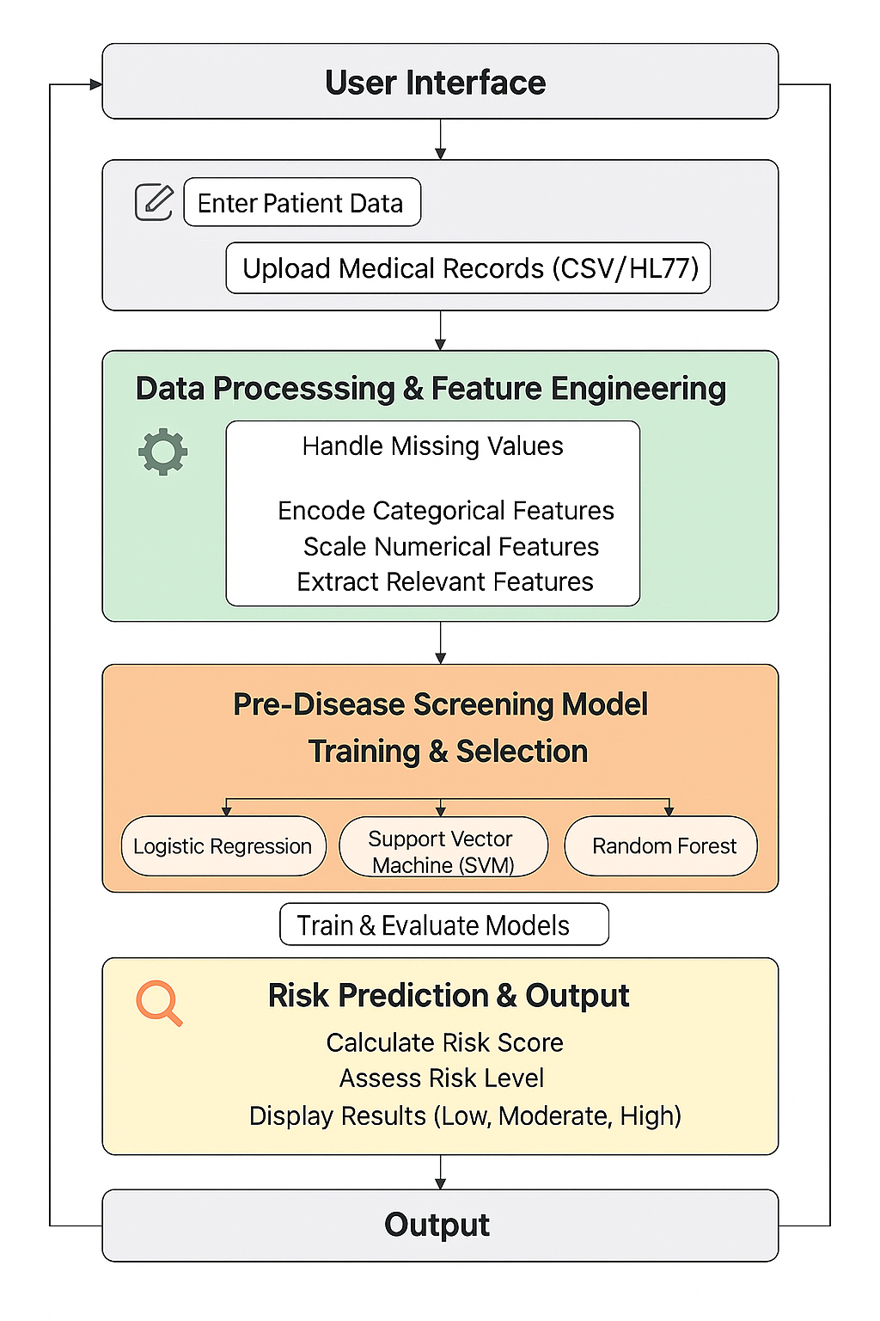
1.SYSTEM ARCHITECTURE
Figure 1: System Architecture Diagram

Slide 11
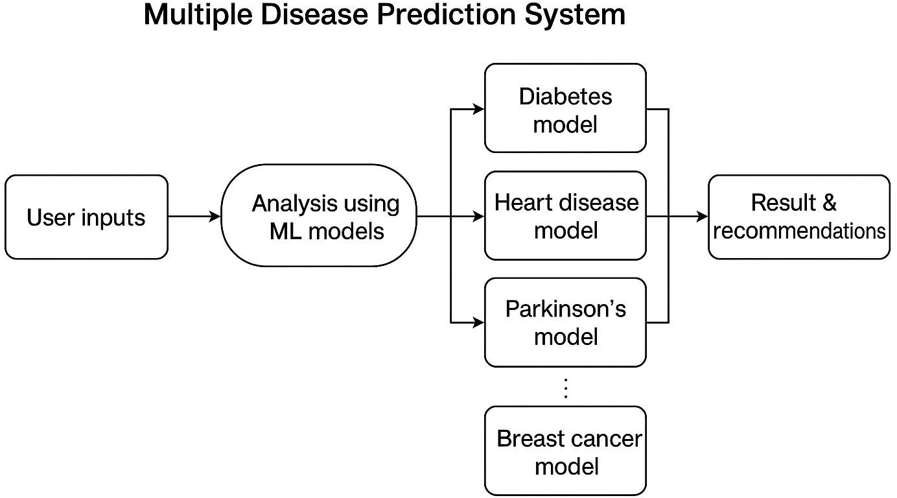
2.DATA FLOW DIAGRAM
Figure 2 : Data flow diagram

Slide 12
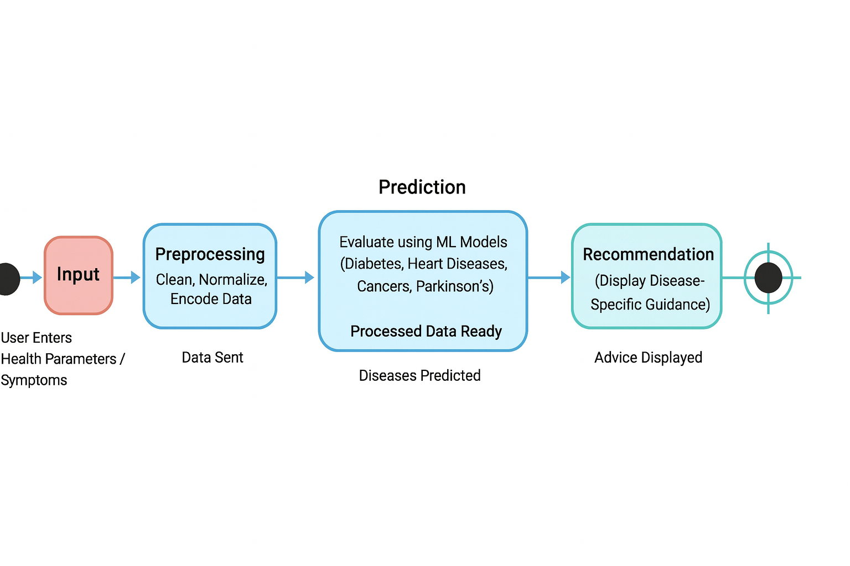
3.STATE CHART DIAGRAM
Figure 3 : State Chart Diagram

Slide 13
SOFTWARE REQUIREMENTS
Category Frontend Backend ML Frameworks Models Used Other Libraries | Tools and Models React.js Python, Flask Scikit-learn, XGBoost, RDKit Random Forest, XGBoost, SVM, Logistic Regression Pandas, NumPy, Matplotlib, Seaborn, Pickle, Joblib, Scipy, Imbalanced-learn

Slide 14
IMPLEMENTATION DETAILS
Module | Description | Tools / Libraries | Input | Output
Data Collection | Acquire datasets (Diabetes, Heart, Parkinson’s, Cancer, Symptom) | CSV files, Kaggle datasets, pandas | Raw CSVs | Raw data tables
Preprocessing | Clean, impute, encode, scale features | pandas, scikit-learn (StandardScaler, LabelEncoder) | Raw tables | X (scaled), y (labels)
Feature Extraction | Select disease-specific features | pandas, domain rules | Preprocessed X | Feature vectors per disease
Model Training | Train classifiers, tune hyperparameters | scikit-learn, xgboost, GridSearchCV | X_train, y_train | Trained model objects (.sav/.pkl)
Model Persistence | Save models & scalers for reuse | pickle / joblib | Trained models, scalers | .sav / .pkl files

Slide 15
Prediction Engine | Load model, preprocess user input, predict | Python, Flask/Streamlit | User inputs | Prediction + probability
Recommendation Module | Map predicted disease → precautions & tips | Custom mapping (JSON/dict) | Prediction label | Recommendation text
Evaluation & Testing | Compute metrics, confusion matrix, cross-val | scikit-learn metrics | y_test, y_pred | Accuracy, Precision, Recall, F1, Confusion Matrix
Deployment (demo) | Local app or simple server for demo | Streamlit / Flask | Models + app code | Runnable application (no APK)
Documentation | User manual, developer notes, how-to-run | Markdown, README | Codebase | Documentation files

Slide 16
PSEUDOCODE of PREDICTION AND DIAGNOSIS MODULE
START
INITIALIZE diseases = ["Diabetes", "Heart Disease", "Parkinson's", "Breast Cancer"]
FOR each disease:
LOAD its required input features
LOAD valid ranges for each feature
LOAD trained ML model for that disease
FUNCTION getUserInput(disease):
DISPLAY required input fields for selected disease
READ user values into form
FOR each input:
IF value is empty:
SHOW error: "All fields are required"
RETURN INVALID
IF value not in valid range:
SHOW error: "Value out of allowed range"
RETURN INVALID
RETURN VALID
FUNCTION preprocessInput(form):
CONVERT all values to numerical format
NORMALIZE or SCALE values (if required by model)
RETURN processedData

Slide 17
FUNCTION predictDisease(disease, processedData):
LOAD selected model
prediction = model.predict(processedData)
IF prediction == 1:
result = "Positive / High Risk"
ELSE:
result = "Negative / Low Risk"
RETURN result
FUNCTION displayResult(disease, result):
IF result is Positive:
SHOW risk card with:
- Disease name
- Danger / Alert message
- Precautions and early intervention tips
ELSE:
SHOW safe status message
FUNCTION resetForm():
CLEAR all input fields
CLEAR error and result
MAIN WORKFLOW:
DISPLAY list of diseases to user
userChoice = SELECT disease
VALID = getUserInput(userChoice)
IF VALID == INVALID:
STOP and ask user to re-enter values
processedData = preprocessInput(form)
result = predictDisease(userChoice, processedData)
displayResult(userChoice, result)
OPTION: Allow user to reset or check another disease
END

Slide 18
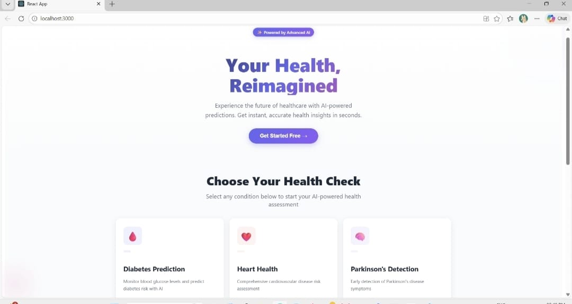
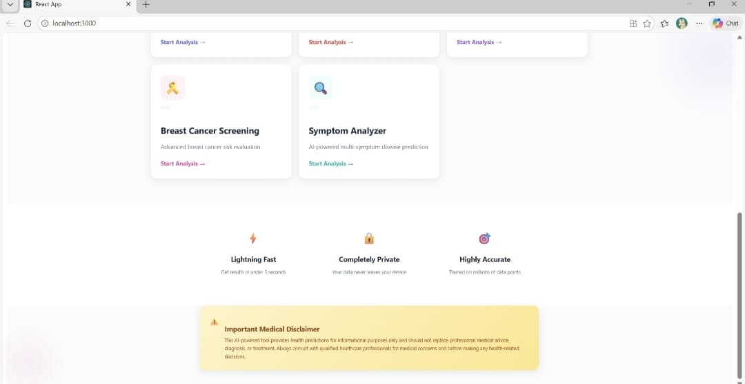
RESULTS AND DISCUSSIONS
Figure 1: Home Page of the System

Slide 19
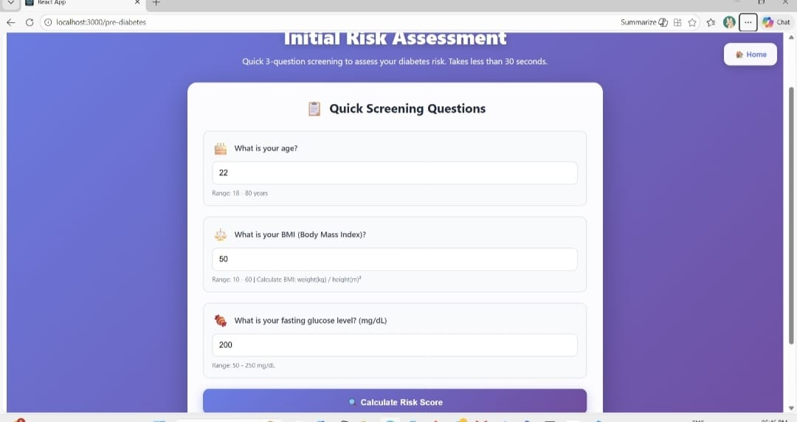
RESULTS AND DISCUSSIONS
Fig 2: Diabetes pre-testing input form

Slide 20
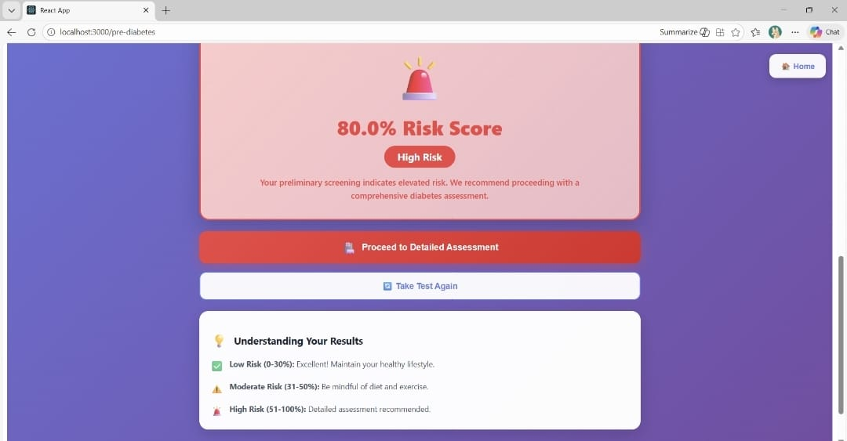
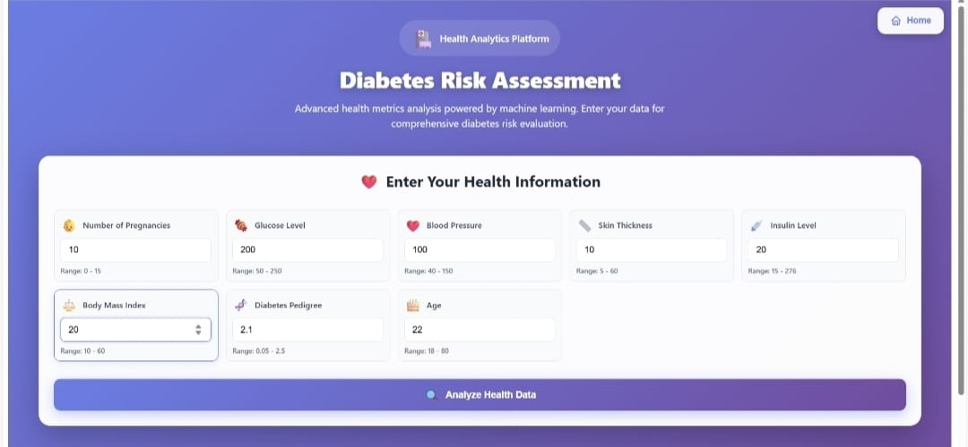
RESULTS AND DISCUSSIONS
Fig 3: Result of pre-testing form
Fig 4: Diabetes risk input form

Slide 21
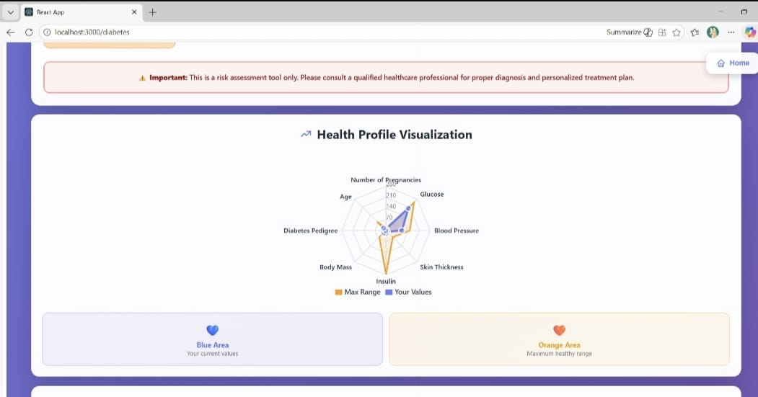
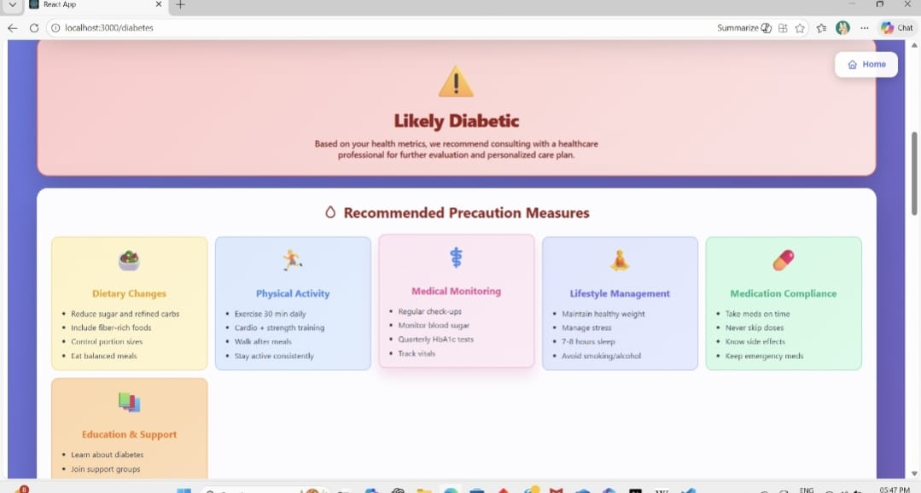
RESULTS AND DISCUSSIONS
Fig 5: Detailed metrics breakdown
Fig 6:Precautionary measures

Slide 22
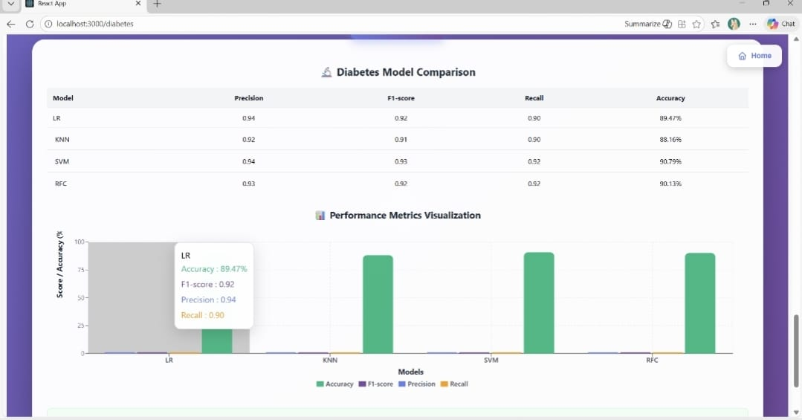
RESULTS AND DISCUSSIONS
Fig 7: Model accuracy comparision

Slide 23
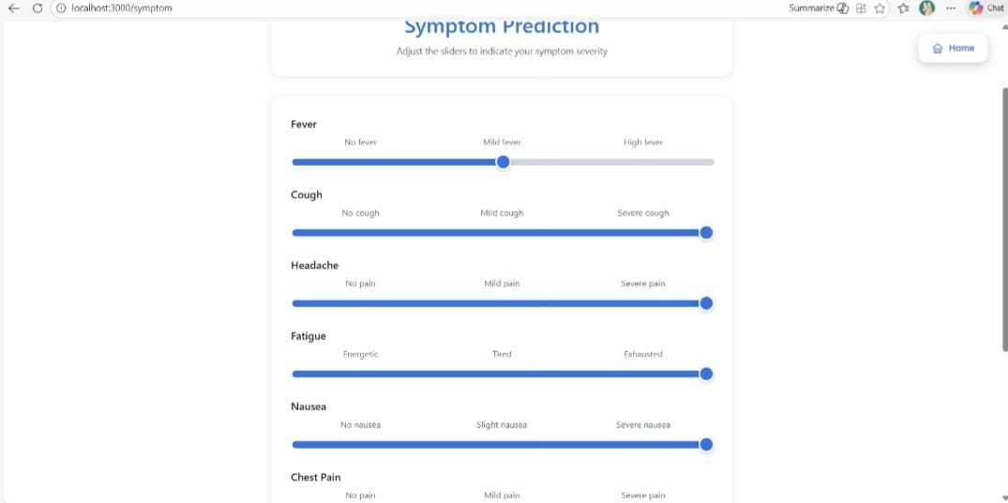
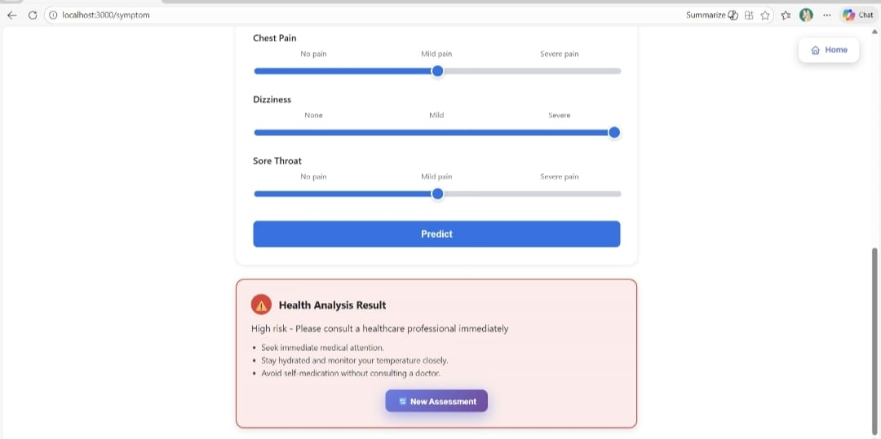
RESULTS AND DISCUSSIONS
Fig 8: Symptoms prediction input sliders
Fig 9: High risk health analysis result

Slide 24
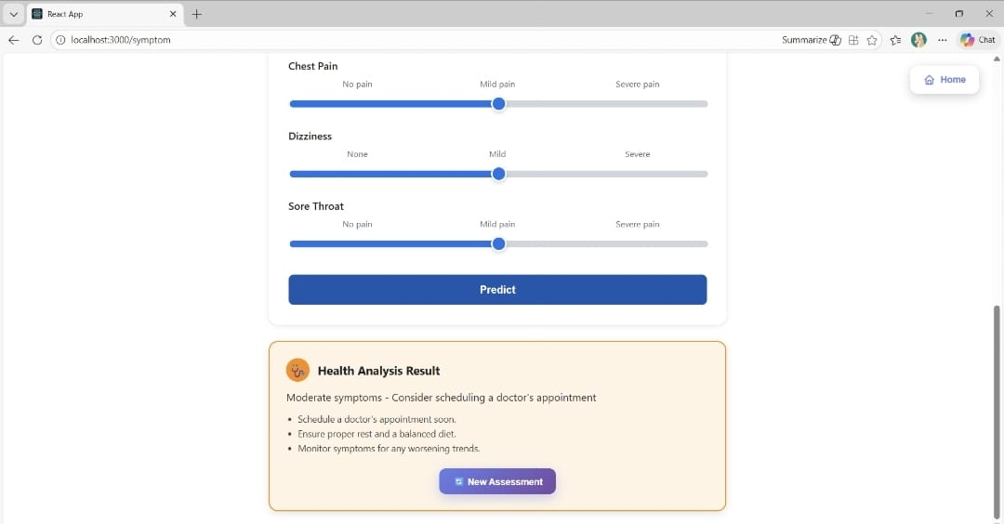
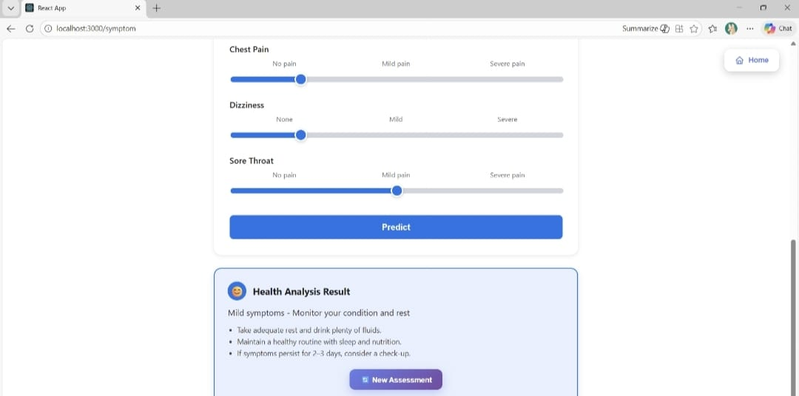
RESULTS AND DISCUSSIONS
Fig 10: Moderate symptoms health analysis result
Fig 11: Mild symptoms health analysis result

Slide 25
Comparison (Existing vs. Proposed)
Aspect | Existing System (Traditional Disease Prediction System) | Proposed Application (Multiple Disease Prediction)
Core Approach | Single-disease models or manual interpretation | Multi-disease ML pipeline (RF, SVM, XGBoost)
Feature Representation | Simple handcrafted features | Scaled numeric features + symptom encoding
Model Variety | One or two classifiers | Separate best-fit model per disease (comparison done)
User Interaction | Manual or spreadsheet-based | Application interface for input & results, APK wording
Output | Single prediction | Multi-disease predictions + probabilities + recommendations

Slide 26
CONCLUSION
The project Multiple Disease Prediction Using Machine Learning demonstrates the effective use of machine learning techniques in healthcare applications. The system accurately predicts multiple diseases and provides a user-friendly interface for preliminary health assessment. The enhanced version improves usability while maintaining prediction accuracy.

Slide 27
Future Enhancement
Can add advanced models, real-time monitoring, multilingual support, and EHR integration for better accuracy and usability.
Applicable in hospitals, tele-medicine, rural health centers, and can be extended to more diseases for early detection and prevention.

Slide 28
REFERENCES
T. Raj, D. Singh and A. Kaur, “A Machine Learning-Based Framework for Prediction of Weather- Related Diseases,” International Journal of Advanced Computer Science and Applications (IJACSA), vol. 11, no. 5, pp. 123–130, 2020.
M. Pawar and A. S. Kapse, “Disease Prediction Using Machine Learning Algorithms,” International Conference on Intelligent Computing and Control Systems (ICICCS), pp. 461–466, 2021. doi:10.1109/ICICCS51141.2021.9432164.
A. Joshi and S. Kulkarni, “Health Monitoring and Prediction System Using Machine Learning,” International Research Journal of Engineering and Technology (IRJET), vol. 8, no. 6, pp. 1500–1505, 2021.
OpenWeatherAPI Documentation, OpenWeather Ltd., Available at: https://openweathermap.org/api
Orvile, “Weather-Related Disease Prediction Dataset,” Kaggle, Available at: https://www.kaggle.com/datasets/orvile/weather-related-disease-prediction-dataset

Slide 29
Thank You

